Slide 1
Covid Task

Slide 2
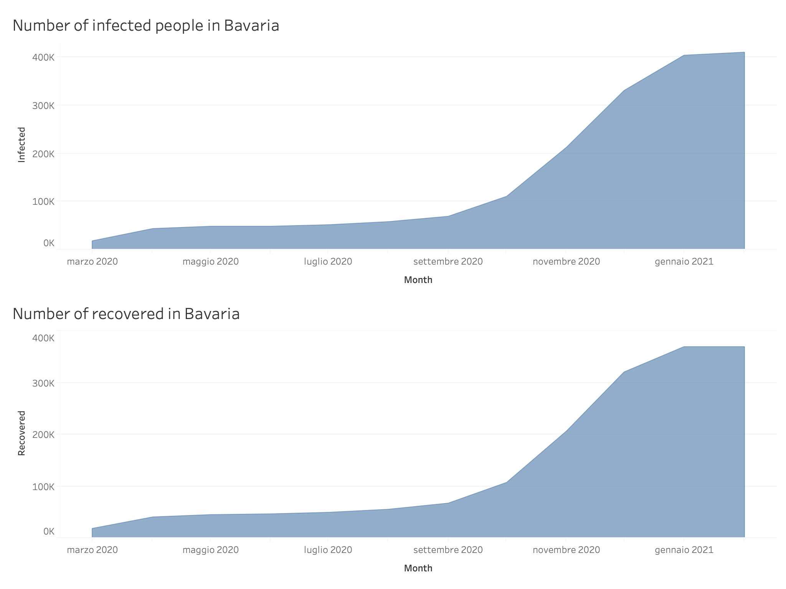

Slide 3
